Slide 1

Student Details
Name : Aadarsh Jain
SkillsBuild Email ID : aadarshjain1266007@gmail.com
College Name : St. Vincent Pallotti College of Engineering & Technology
College State : Nagpur , Maharashtra
Internship Domain : Data Analytics (DA)- Case study: Analysis of superstore database
12-06-2023 - 24-07-2023

Slide 2
Case Study : Analysis of superstore
Problem Statement

Slide 3



PROJECT TOPIC
Basic Definitions and terminologies in the sample data
Superstore being a big Sales giant to Various Segments i.e. Consumers, Corporates and Home Offices.
Product Categories are the broader Product Types that the store deals in i.e. Furniture, Office Supplies
and Technology.
Sales : The amount of goods sold by the Superstore. Sales is aggregate of (#products sold * Unit Price )
of each product)
Profit : Earning of Superstore after selling the Goods. This is calculated as (Selling Price – Buying Price)
for all goods.

Slide 4






AGENDA
Introduction:
Overview of the Superstore and its business operations.
Explanation of the purpose and scope of the analysis.
Data Collection and Preparation:
Description of the data sources used for the analysis.
Discussion of the data cleaning, transformation, and preprocessing steps undertaken.
Descriptive Analysis:
Examination of the key characteristics and features of the Superstore data.
Summary statistics, such as mean, median, mode, and standard deviation, for relevant variables.
Visualizations, such as bar charts, and pie plots, to explore the data distribution and relationships.
Sales Analysis:
Evaluation of sales performance across different product categories, regions, or time periods.
Identification of top-selling products and their profitability.

Slide 5

PROJECT OVERVIEW
As we take an example most of the business or organizations want a system to Analyze the different categories and their sales and profit generated from those categories. Correct Data and Features is very important for making Analysis more useful. Generally, the Superstore Owners uses manually by the checking the bills and check with the entry in their system. In the manual system the owner barely gets the useful insights from the entry in their system and therefore they are unable to take Accurate and fast Decision.
In this project I had done Analysis of the Superstore on the basis of the features like Product , Ship Mode, Segment, Country, City, State, Region, Category, Sub-Category, Sales, Quantity, Discount, Profit

Slide 6

WHO ARE THE END USERS?
The end users of the Superstore analysis can vary depending on the organization and the specific goals of the analysis. Here are some potential end users who may benefit from the analysis:
Management Team: Executives and senior managers who make strategic decisions for the Superstore.
Sales and Marketing Teams: Sales managers, sales representatives, and marketing professionals can leverage the analysis to understand customer preferences
Finance Department: Finance professionals can use the analysis to gain insights into the financial performance of the Superstore
Business Analysts: Data analysts and business intelligence professionals can use the analysis to dig deeper into the data, create dashboards and visualizations, and provide ongoing monitoring

Slide 7
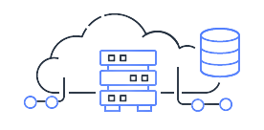
SOLUTION AND PRESENTATION
Solution: Sales and Profitability Optimization for Superstore.
The comprehensive sales and profitability analysis conducted for the Superstore provided valuable insights to address key business challenges. By understanding customer preferences, optimizing pricing strategies, and focusing on top-selling products, the Superstore can drive sales and revenue growth.
The implementation of data-driven decisions, such as inventory management optimization and cost reduction in the supply chain, enhances overall operational efficiency and increases profitability.

Slide 8



WOW IN SYSTEM
Flexibility
Agile Methodology
Continuous Integration and Continuous Deployment (CI/CD)
Customer-Centric Approach
Data-Driven Decision Making
Design Thinking
Remote Worlk
Data and analytics

Slide 9
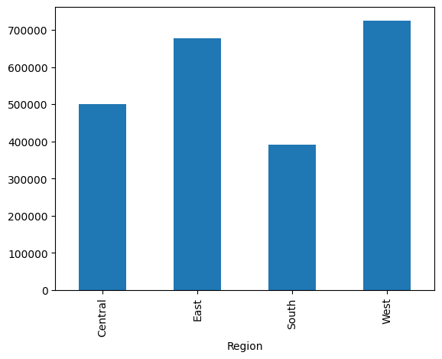
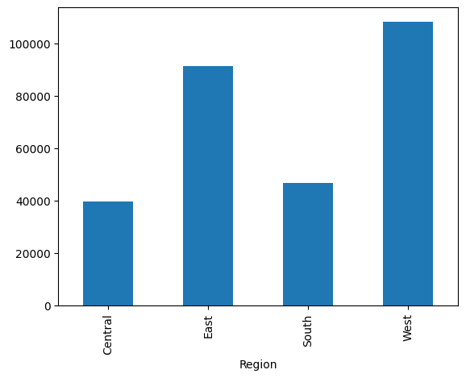
MODELLING
Sales in Different Regions
Profit in Different Regions

Slide 10
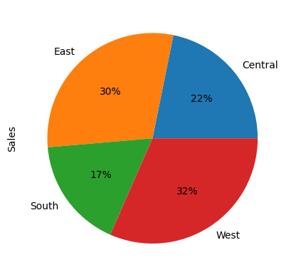
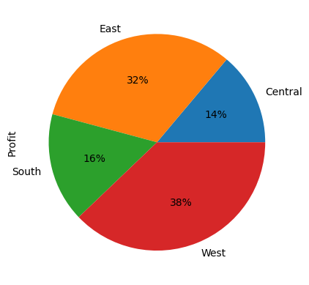
Sales in Different Regions
Profit in Different Regions

Slide 11
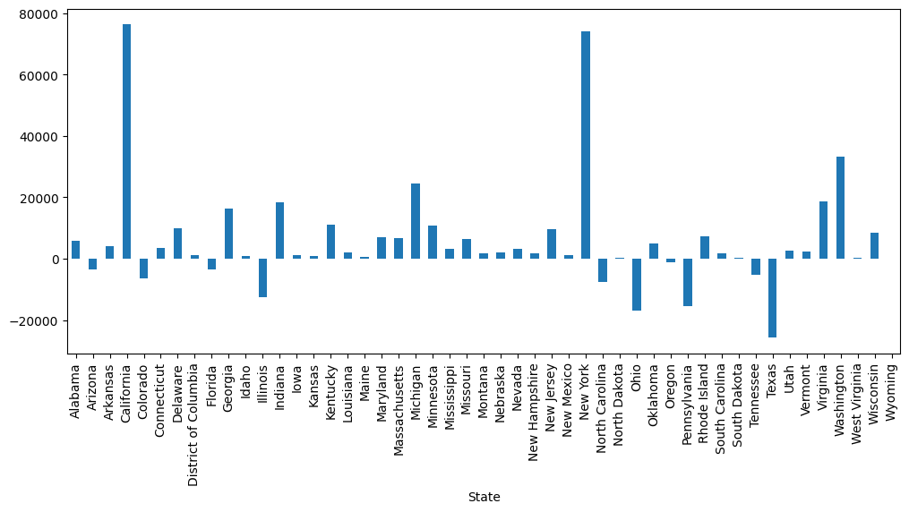
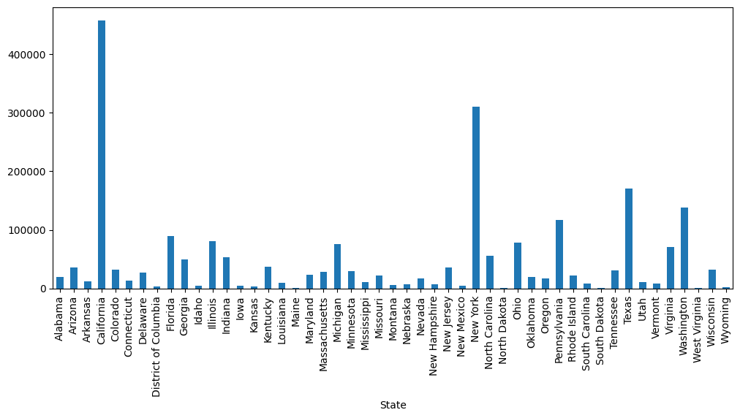
Profit in Different States
Sales in Different States

Slide 12
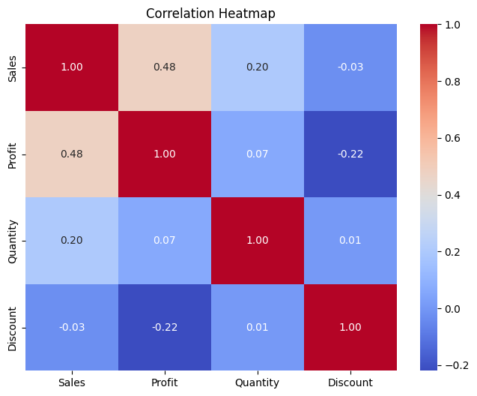
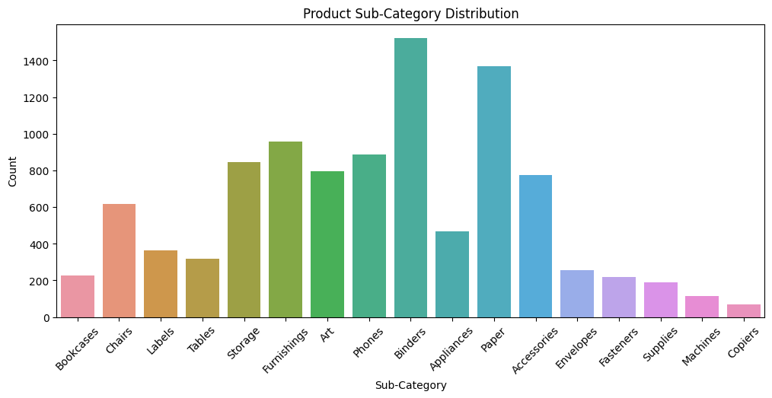
Product Sub-Category Distribution
Correlation Heatmap

Slide 13
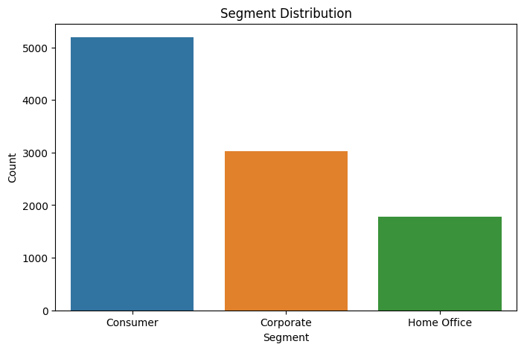
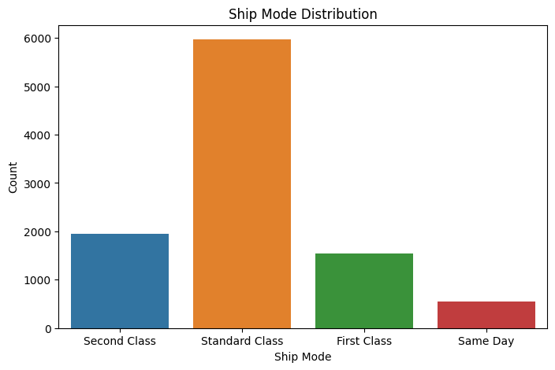
Segment distribution
Product Category Distribution

Slide 14








RESULTS
The Superstore sales analysis revealed valuable insights to optimize business performance. Electronics emerged as the top revenue-generating category, while the Western region showed the highest sales contribution. A positive sales trend was observed over the past year, with notable growth during the holiday season. Customer segmentation identified distinct purchasing behaviors among Retail, Corporate, and Home Office segments. The analysis identified high-profit-margin products and offered recommendations for inventory management. Supplier performance evaluation highlighted reliable and high-quality suppliers. Customer satisfaction assessment provided areas for improvement.
https://github.com/jadarshj/SuperStoreAnalysis/blob/main/SuperStore%20Analysis/Submission_SuperStore_Analysis.ipynb

Slide 15
LINKS
links or references of resources
https://matplotlib.org/
https://seaborn.pydata.org/
Project Link
https://github.com/jadarshj/SuperStoreAnalysis/blob/main/SuperStore%20Analysis/Submission_SuperStore_Analysis.ipynb

Slide 16

THANK YOU..

